Slide 1
Hilarie Koplow-McAdams
Chief Revenue Officer
Notes:
Super exciting to see (Blank and Blank) recognized for their work… Congratulations!
Wow… what a year… what a year indeed… As reflected earlier in the program, we executed so many changes to help us achieve our growth goals. Interestingly, most people think the biggest shift in our direction was going public…
A few weeks ago, Lew and I were asked by a set of executives in Palo Alto what the biggest difference was in the company after going public a year ago.

Slide 2
Notes:
Talking Pts:
I want to start with a story.
Dinner story: What’s new? Platform

Slide 3
Notes:
Platform that Jim just talked about.
Incredible technology that’s delivering real value today.
No longer talking about point products, but the value of the integrated Software Analytics SaaS platform.
Huge upside for us, huge opportunity for our customers.

Slide 4
Year of the Platform
Application Performance
Customer Experience
Business Success
Multi-Tenant SaaS Architecture
Security
Auto-Upgrades
Scalability
Notes:
This is our huge oppty

Slide 5
FY15: A lot of heavy lifting
Segmentation
&
Globalization
Enterprise Expansion
Record Breaking Deals
Customer
Success
Follow the Sun
Community
Expert Services
Three Products
Launched
Doubled the org
Notes:
But I want to take a moment and really reflect on FY15, and all that we accomplished across the org.
Let’s start with Customer Success since that was a top goal a year ago.
Headcount
Segmenting
Follow the sun support
Community
And, we closed Record Breaking Deals… in fact each quarter, we tended to break the prior quarter’s record. Let’s look at some of those deals.

Slide 6


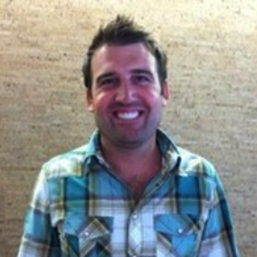
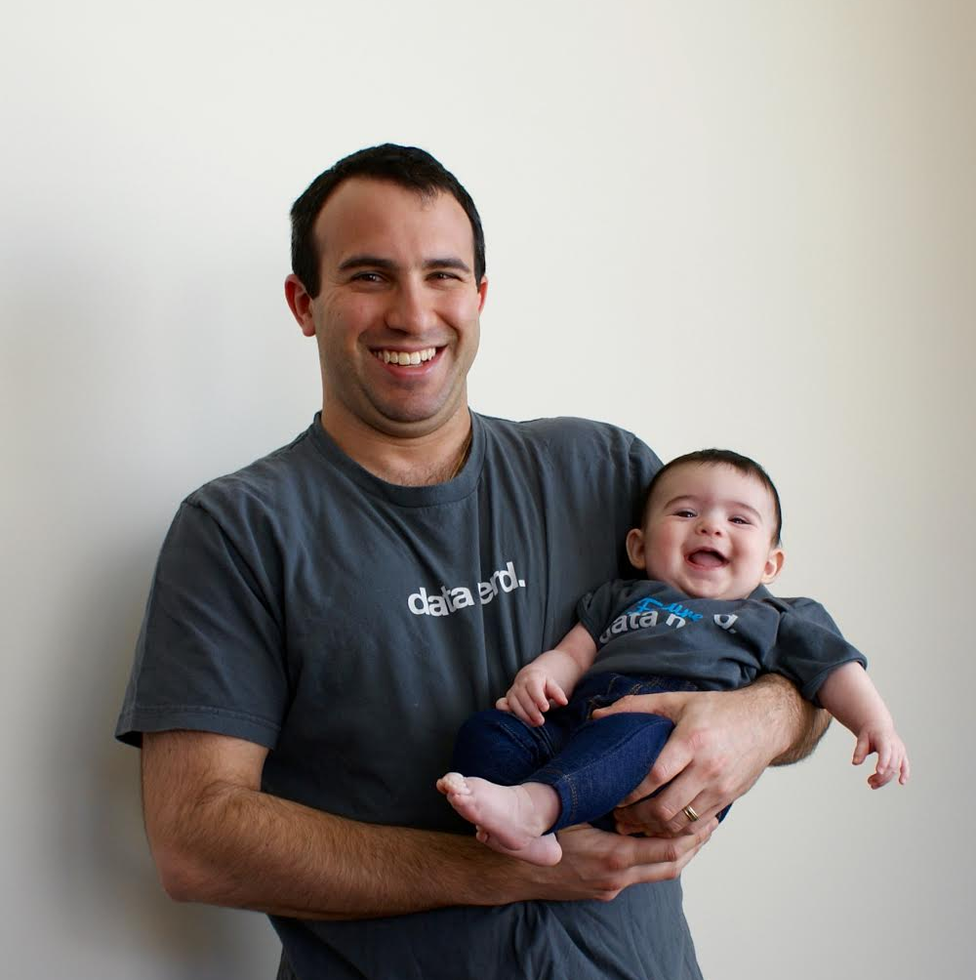




Record Breaking Deals
Big New
AE: Adam Morrison
TAM: Seth Schwartzman
AE’s: Marshall Villarosa; Rudy Arguello
Ent SE: Swati Joshi
Big Expansion
AE: Adam Morrison
TAM: Seth Schwartzman
Notes:
This past quarter, we saw an unbelievable win at the Department of Homeland Security within the Immigration organization. The government was rolling the automation of Immigration application and status checking process to support the Immigration Reform. This was a human process that was moved to electronic form. The swat team on Healthcare.gov asked the key questions – how are you handling monitoring? Believe it not, the answer was we don’t monitor. Stop the clocks – that’s when we came and AppD arrived.
We won on reputation,
speed of deployment,
ease of use with a contractor labor pool,
Breadth of visibility.
And, believe it or not, this is our seed deal – at seven figures. They like what they are seeing so much that they want to roll out NR to field offices.
We were invited to help fix the V2.0 rollout of Electronic Immigration Elis2
Healthcare.gov – Almost 2,000 hosts… 6 million people have signed up for Healthcare.gov and the expectation is 60 million. Insights – APA – real-time ability to drill down into errors coming from? In their world, they still look at real-time, percentiles to measure customer experience. Public SLA that are reported on CNN, they can validate in New Relic. Browser helps them find where errors reside by location.
Walmart started way back in 2011. Last year, they piloted us in Brazil with great success. So this fall they adopted, Walmart.com, Walmart Mobile eCommerce, which led adoption at Sam’s Club and many of their international properties. Insights is being used for application performance analytics. It was multi-year, team effort to win – Rudy Arguello led the int’l charge, Marshall Villarossa and Swati Joshi took on USA. Hi-Five to you all…

Slide 7
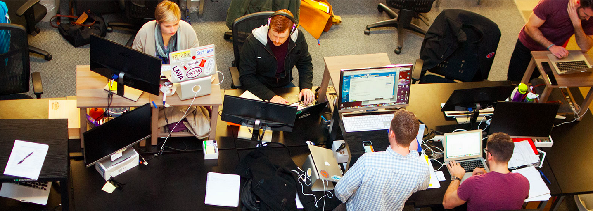

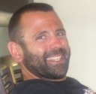

Vungle
$300K
AE: Jim Balestrieri
SE: David Yu
Notes:
This is such a cool story… Vungle is an ad platform for developers powering video ads – If you have played Candy Crush or Clash of Clans, you have seen ther ads.
You can only imagine the number one concern in this environment is step one – “Is it working?” Y/N. What should we debug? NR provides that visibility.
But at Futurestack ‘14, they realized they could go deeper into measuring the Customer Experience and ulitmately move to making business decisions using Insights. AND, replace their ELK stack while at it!
So now, they measure performance, but also WHO is using it, WHEN was it streamed, WHAT did it do
and did it result in someone installing another app (ie, Business Success – AKA Cha-Ching). What’s next – Synthetics and Mobile, of course!
Jim Balestreiri and Will Li, Hi-Five!
So, let’s how do we get other customers to follow the path of Vungle’s journey?

Slide 8
A World Where Software Analytics is Not Valued
0
Reactive Application Performance
Notes:
Hopefully, they already recognize that the world where software analytics is not valued is not a pretty world…
It’s a world where fires burn bright (and this is not a good thing).
It’s a world of finger pointing and lost dollars.
Everyone’s unhappy, especially the big bosses,
and it is a world where Twitter and CNN are scary because this is where real-time monitoring analytics

Slide 9
Delivering Great Software Experiences –
the Software Analytics Maturity Model
3
Data-Driven Software Business
2
Customer Experience Management
1
Proactive Performance Management
0
Reactive Application Performance
Notes:
Ok, so how do we help our customers avoid that world…
First of all, have always prided ourselves on teaching our customers what “delivering great software experiences” looks like…
But, we realized to be effective in teaching organizations how to adopt our platform we needed a framework…
MATURITY MODEL
Land (stick in the eye) -> Expand (other pieces)
How do buyers buy
Pt problem , then build on this
Multiple points of entry
Platform helps go further faster
Can’t predict how fast they’ll move,
“Our time is now” theme, the market is moving fast, we need to move fast

Slide 10





































Delivering Great Software Experiences –
the Software Analytics Maturity Model
3
Data-Driven Software Business
2
Customer Experience Management
1
Proactive Performance Management
0
Reactive Application Performance
Notes:
Ok, so we have always prided ourselves on teaching our customers what “delivering great software experiences” looks like… But, we realized
MATURITY MODEL
Land (stick in the eye) -> Expand (other pieces)
How do buyers buy
Pt problem , then build on this
Multiple points of entry
Platform helps go further faster
Can’t predict how fast they’ll move,
“Our time is now” theme, the market is moving fast, we need to move fast

Slide 11

Going BIG in FY16, but a word about the importance of users
Notes:
Going big in FY16: Our time is now

Slide 12
Play #1 - Account Management Model
SMB From
Hunter/Farmer to Account Management
Enterprise
Account Mgmt
Expansion
Impactful
Customer Success Programs
Notes:
Accountant Mgmt Model – helps us achieve two goals. Sell the platform… solve bigger problems… be trusted by customers to play a strategic position.
The deeper our relationships, the more we are trusted.
To get to the top ten, your customers must feel they have a relationship with the company.

Slide 13














Play #2 – Globalization Helps Us Take the Lead
Top 5
Emerging 5
Germany
USA
UK
Canada
Australia
Brazil
Globalization Continues
Nordics*
France
Japan
Mexico
35% of Business is Non-US
Notes:
And, we’re already seeing tremendous demand from customers globally without a concerted effort.
This year, we will be picking bets across our top 5, and focusing on expanding those deals where we have small beachheads
You’ll see added headcount and partnerships to help us in key markets.

Slide 14
Play #3 – Getting to Frictionless Pricing… Or, Almost
Cloud Hosts Come in all
Different Shapes & Sizes
…and so do Customers
Public Clouds Are
Dynamic By Nature
Simplicity
Coming Soon…
Phase 1 of
CPU Pricing
Coming Soon…
Flex Pricing
ELA & Bundles
Notes:
We recognize as our customers move into increasingly complex private and public cloud architectures that our base measure of hosts starts breaking down. This is because cloud hosts come in all shapes in sizes. Yet at their core, cloud hosts are made up of cpu’s. This more granular measure s a better measure for us in the world of cloud hosts.
This past quarter, we piloted leveraging “CPU” pricing in lieu of “Hosts” as a pilot program and helped match the appropriate value to customer’s CPU count. It was a great success.
Our customers cloud hosts increasingly come in all different shapes and sizes. We recognize our current measure of hosts, sometimes breakdowsn
Pricing works (charge by host)
But
Oppty to align pricing to trends (move to cloud)
Solving these problems:
1.One price doesn’t fit all in the cloud (pricing by host when they are virtual, etc)
2. More flex in how they use what purchase in dynamic environment
What we have learned, cust want most if not all products, therefore explore easier ways
Platform pricing – to rollout NR to entire org (Bundle or ELA)
Proof: Q4 pilot - ex of rescued deals with cloud pricing

Slide 15


















Play #4 – Build Out a Frictionless Ecosystem
Strategic Alliances
Platform Alliances
MSP & Resellers
Ecosystem Partners
Etc…
Notes:
No one wins alone… Partners are a force multiplier in the world of software…. And, we have increasing numbers of friends who will help us drive success with our customers.
No one wins alone…

Slide 16
Play #5 – The Grand Slam
Application Performance
Customer Experience
Business Success
Multi-Tenant SaaS Architecture
Security
Auto-Upgrades
Scalability
Notes:
This is our huge oppty

Slide 17
Going BIG in FY16, but a word about the importance of users
Notes:
Going big in FY16: Our time is now

Slide 18



Users are King
Accountant
Sales Person
Developer & Dev Ops
Notes:
Copy the slide from Lew’s deck with the three logos (Disney, Apple, NR)
And make the logos Intuit, Salesforce and NR

Slide 19




READY FOR TAKEOFF
LET’S DO THIS!
Notes:
3. The heavy lifting is behind us
Right strategy, ready to go fast, push down the accelerator
Ready for takeoff
Past year was heavy lifting… all about putting foot on accelerator
Year of the platform – leave the audience with this to remember
Year of the platform on the side of a rocket ship
Or image of car (pedal to the metal)

